Slide 1
Delivering Sustainable AI-Scale Data Centers
Introduction to Start Campus and SINES DC
October 2025

Slide 2
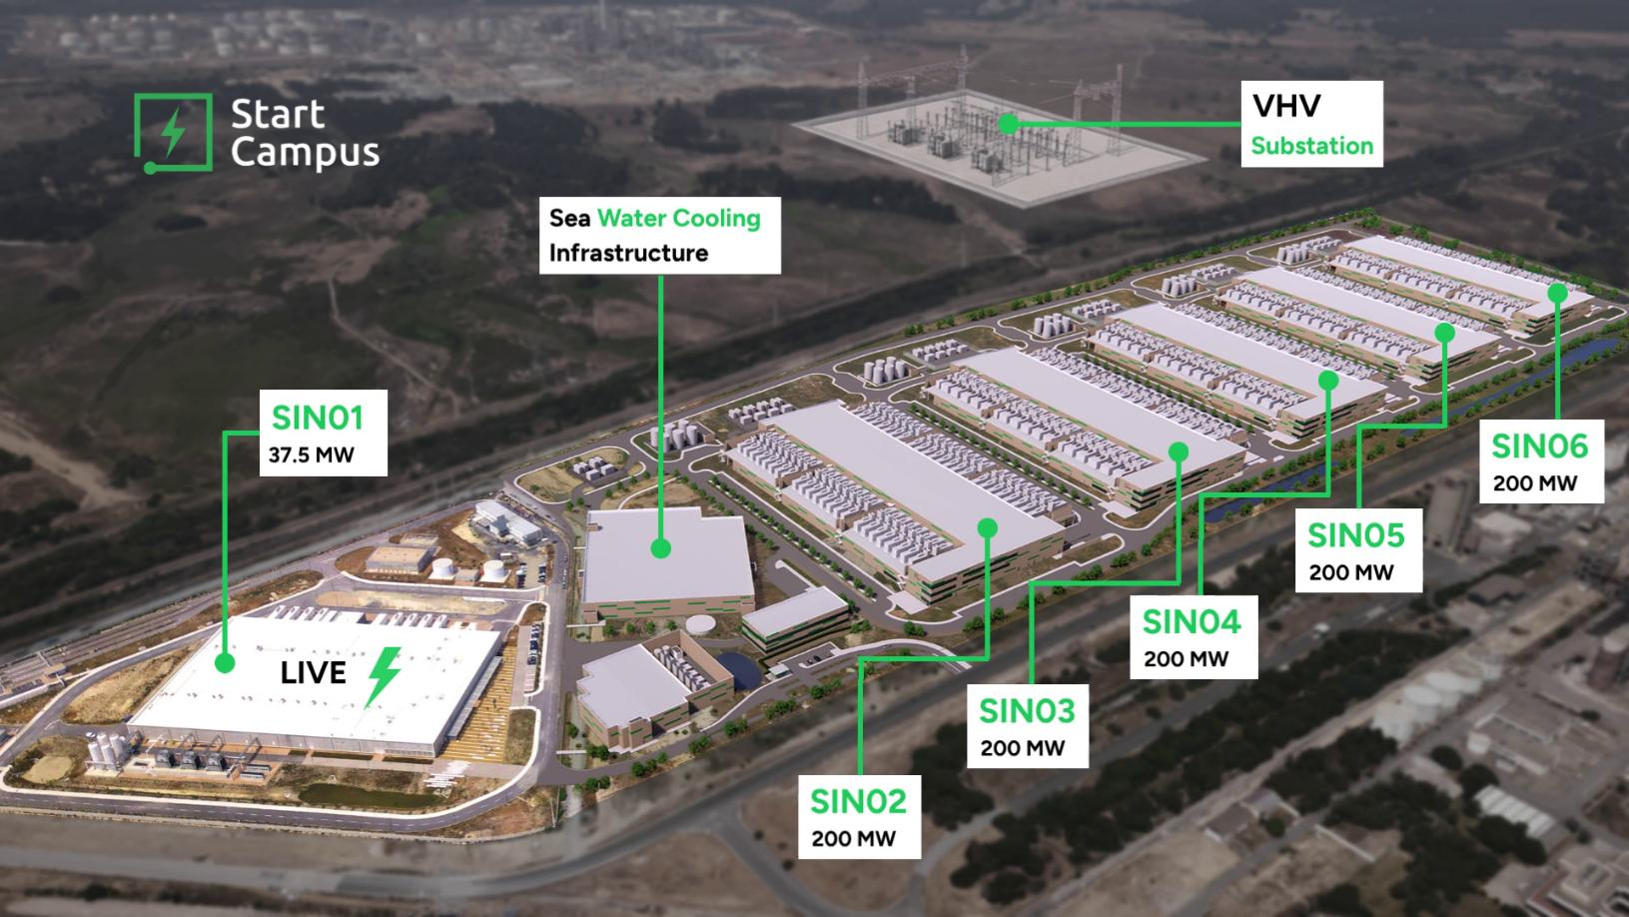
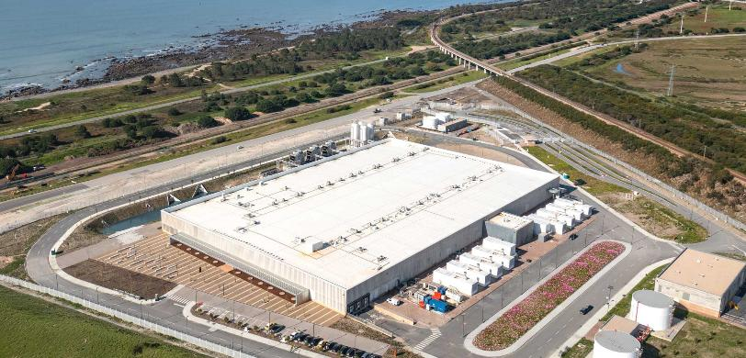


SIN01
SINES DC
Europe’s First Giga-Scale AI Factory
Sines, Portugal
Site Coordinates: 37.934961, -8.812558 | c. 90 km south of Lisbon
1.2 GW
IT capacity
100%
grid capacity secured
Low PUE and 0 WUE using sea-water cooling
1.2GW campus, 180MW ready-to-build
14MW operational, expanding to 31MW
AI-ready design, OCP v2-certified
PUE
Low cost and 100% renewable power
2027
60MW+ capacity available
600kW
racks
supported
Low latencies to all major cities
www.startcampus.pt | sales@startcampus.pt

Slide 3
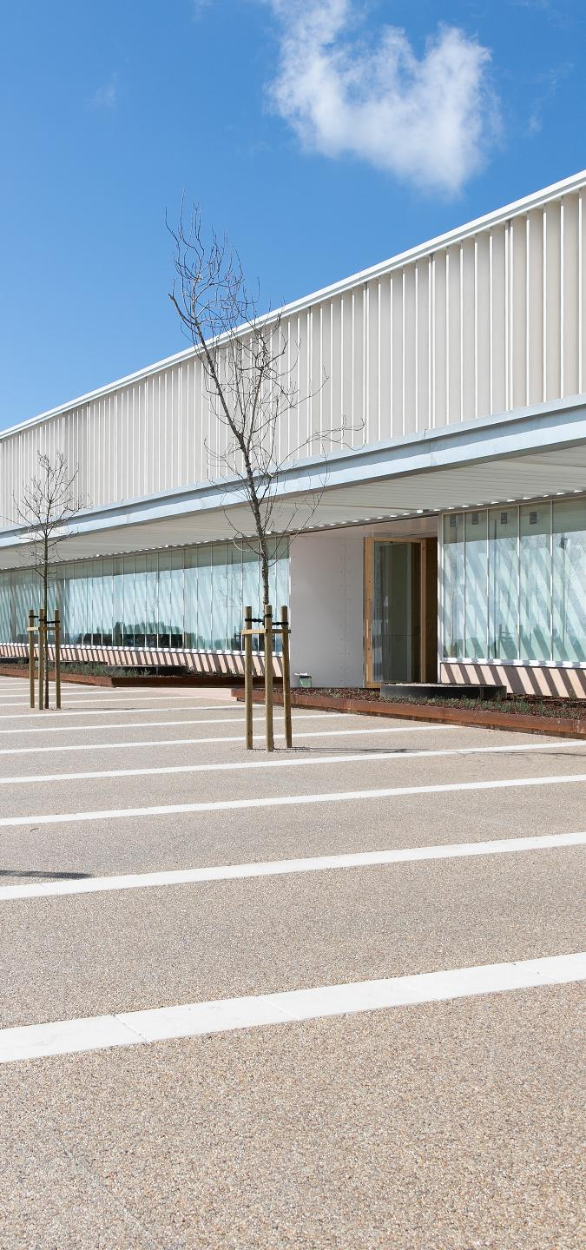
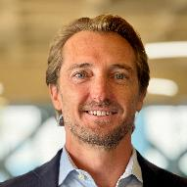
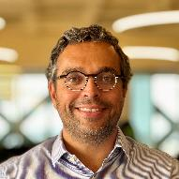
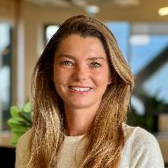







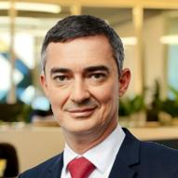
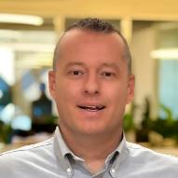






















Management Team with deep experience
Backed by two world-class investors
Global investment management firm with c. $38bn in assets under management
Robert Dunn
Chief Executive Officer
Luis Rodrigues
Chief Operating Officer
Caroline Romanski
Chief Corporate Officer
Precedent experience
Precedent experience
Precedent experience
European specialist investor with >20 yrs track record in energy, environment, water and data infrastructure
Supported by a team with proven track-record
Nicolas Le Brouster
Chief Financial Officer
Omer Wilson
Chief Marketing Officer
Warren Barrie
Chief Revenue Officer
Precedent experience
Precedent experience
Precedent experience
c. 70
FTE organization,
scaled for growth
c. 4 GW
combined global DC experience
2
Highly experienced investors
¹ Non-exhaustive list of partners that delivered the operational SIN01 building

Slide 4
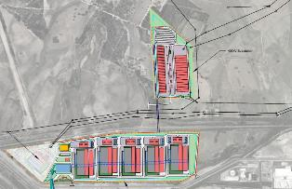
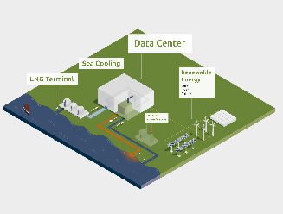
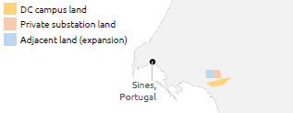
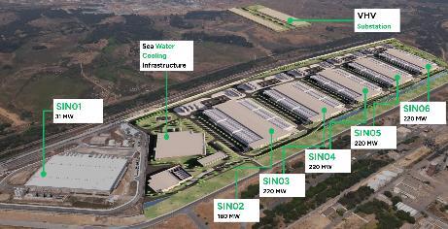
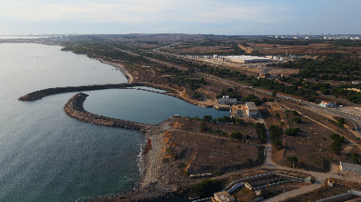
SIN02-06 is one of the most “ready-to-build” and de-risked data center projects currently in development globally
Secured,
Redundant
Power
Access
Grid access secured for the full 1.2 GW campus, with redundant lines:
Firm grid access secured for up to c. 1.5 GVA
Private substation connected to the grid
Long-lead transformers for SIN02+ ordered from Siemens¹
Start Campus’ private substation
Two redundant 400kV grid access lines to campus' substation
Redundant
Seawater
Resources
Water rights agreed for seawater sources, covering the cooling needs of SIN02-06 with redundancy:
Re-purposed seawater infrastructure from decommissioned coal power plant (20-yr agreement)
Repurposed, existing seawater infrastructure from decommissioned coal-fired
power plant ( )
Secured
Land
Long-term surface rights (150 yrs) secured for the development of the full campus (DC and Power)
~60 ha (148 acres) for DC campus in Sines
~20 ha (49 acres) for private substation
Secured
Environmental Licensing
Approved environment permit (DIA) for the full campus, incl:
6 data center buildings
400kV substation and redundant 400kV lines
Expansion of seawater infrastructure & use rights
¹ To be delivered in Q1’26

Slide 5
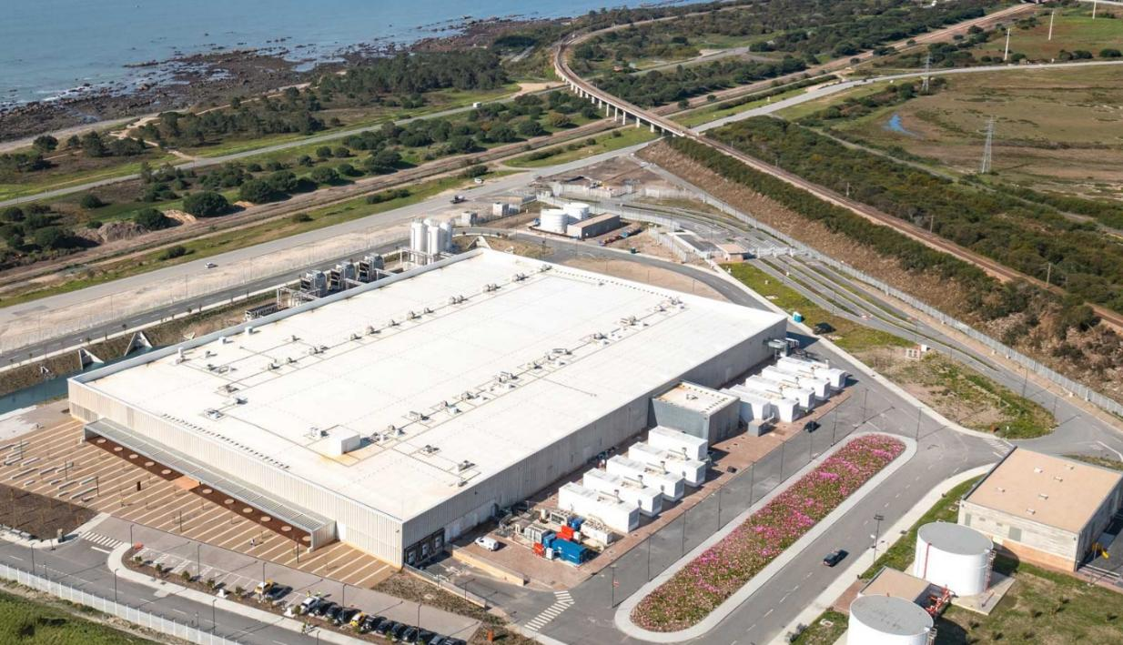
What Sets Us Apart | Start Campus is perfectly positioned to support the rapid growth of AI in Europe
Scalability, able to deliver 1.2GW in a single campus
Time-to-market, able to deliver 180MW in 2027
Flexible infrastructure, able to accommodate increasing rack densities
World-class team, with experience delivering and operating high-density capacity
Full turnkey solution, incl. project, design and construction management
Ultra-low latencies, to Europe and beyond
Efficient and sustainable operations, with seawater cooling and renewable power

Slide 6
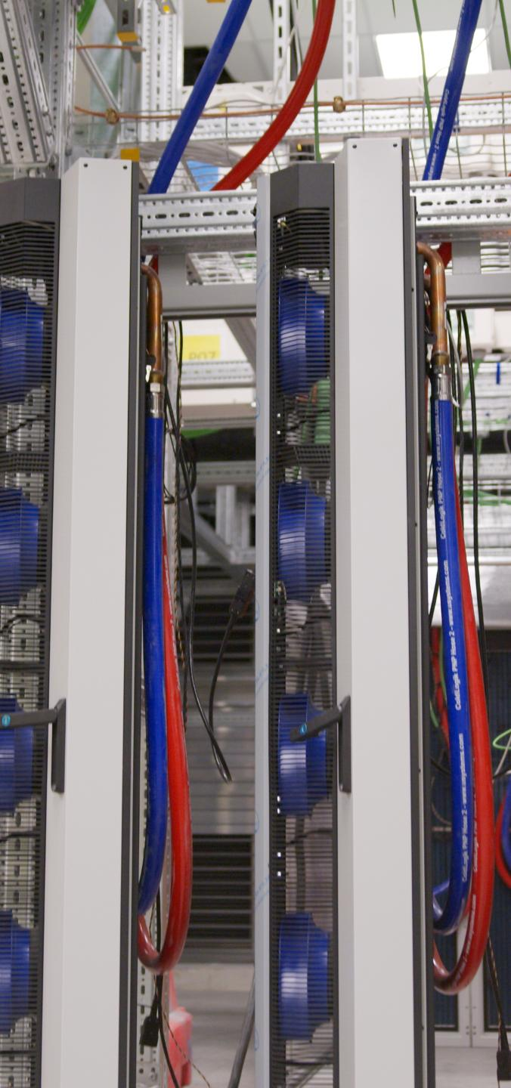
Appendix:
An unmatched power, cooling and connectivity advantage

Slide 7



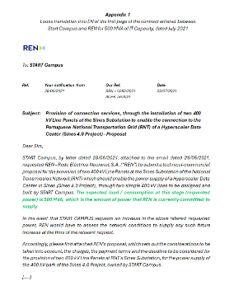
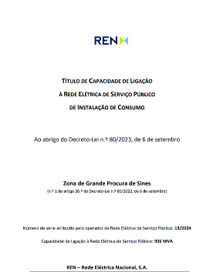
Scaling with c. 1.5 GVA of grid access fully secured
Grid access
fully secured (1.5 GVA)
Transformers Ordered
Campus in development
Benefits to
Start Campus’ customers:
Execution certainty, with no additional local or utilities’ approvals required
Timeline visibility, with high-demand, long-lead time transformers already ordered in Aug’24
Scalability potential, with clear path and capacity to expand operations
Savings on costs, through access to VHV grid charges vs. HV charges
1.5 GVA enables to support
up to 1.2 GW of IT capacity
Long lead-time equipment
Timeline and execution derisked with grid access & transformers
Start Campus Substation
SIN06
SIN05
Connections to Power Grid (2x 400 kV)
SIN04
SIN03
SIN02
 1.5 GVA 
Seawater cooling building
Ability connect to renewable sources
Note: representation of incremental grid capacity secured for SIN02-06 (936 MVA), in addition to the 500 MVA previously secured for SIN02-06; grid capacity for SIN01 separately already secured; all capacity subject to conformity to power draw schedule agreed with REN

Slide 8

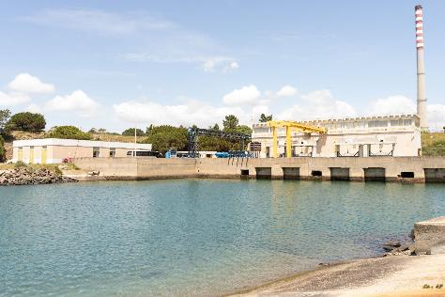
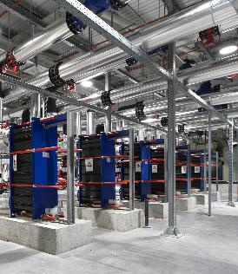
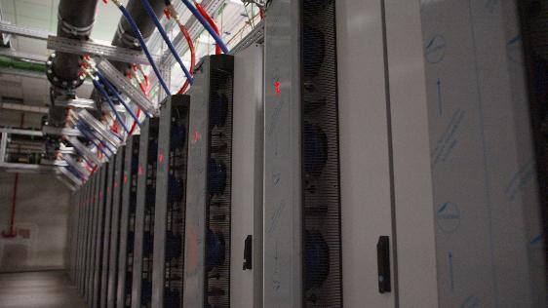
By combining seawater and liquid cooling, Start Campus offers an ultra-efficient thermal backbone for AI workloads at scale
Sea Water System
(Open Loop)
Process Cooling Water
(Closed Loop)
100% Liquid cooling
Air cooling (fan walls)
Hybrid air & liquid cooling
Heat Exchanger
Data Center
Atlantic Ocean
Key benefits
Lower operating costs, with unmatched efficiency and low PUE
Industry-leading sustainability credentials, incl. reduced CO₂ emissions, zero potable water use
Consistent performance and uptime with resilient, thermally stable cooling
Reduced fitout capex required
Intake basin
Rear-door installed

Slide 9
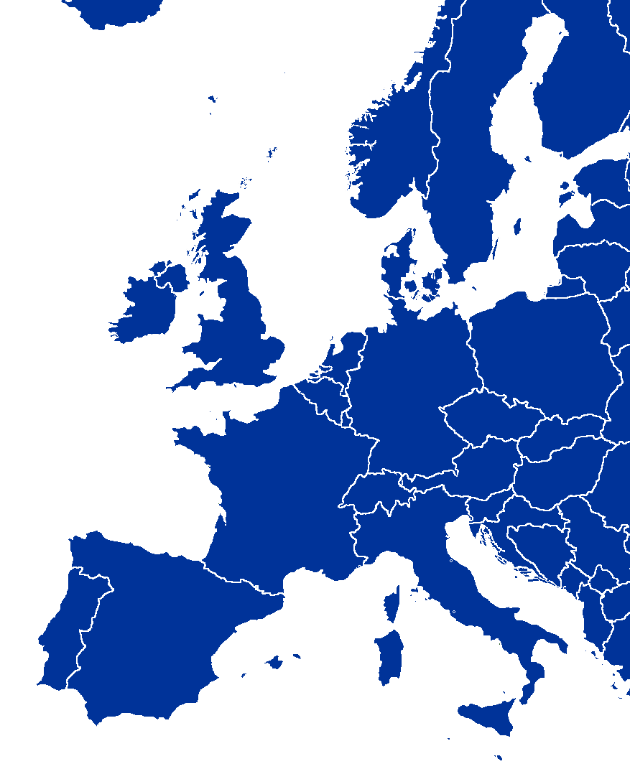
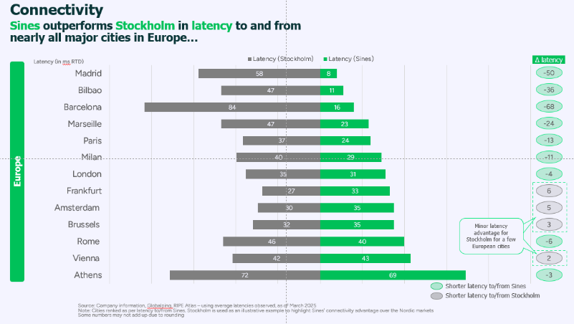
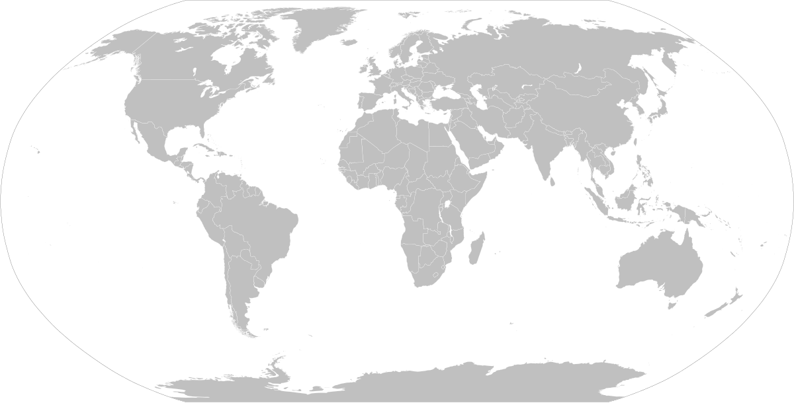
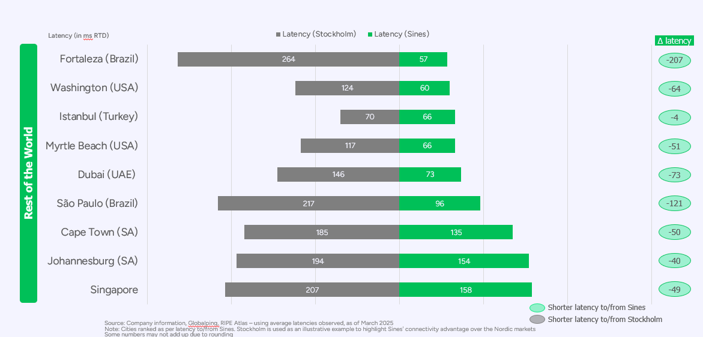
Portugal offers low and ultra-low latencies to Europe and the rest of the world
RTD latencies (ms)
Did you know? Portugal outperforms Stockholm in latency to and from
nearly all major cities in Europe
Dublin
41ms
Sines
Istanbul
66ms
Amsterdam
35ms
Myrtle Beach
66ms
London
31ms
Dubai
73ms
Frankfurt
33ms
Singapore
158ms
Paris
24ms
Fortaleza
57ms
Sao Paulo
96ms
Milan
29ms
Cape Town
135ms
Bilbao
11ms
Marseille
23ms
Madrid
8ms
Barcelona
16ms
Rome
40ms
Sines
Did you know? Portugal has an undisputed advantage for latency to and from the Americas and the rest of the world compared to any city in Europe
Under 20ms
Under 25ms
Under 35ms
Source: Company information
Europe
Iberian Peninsula within 16ms RTD
FLAP-D markets within 35ms RTD
Intercontinental
North America from c. 66ms RTD
South America from c. 57s RTD
Africa within 154ms RTD (Johannesburg)
Middle East within 73ms RTD (Dubai)
Asia within 158ms RTD (Singapore)

Slide 10
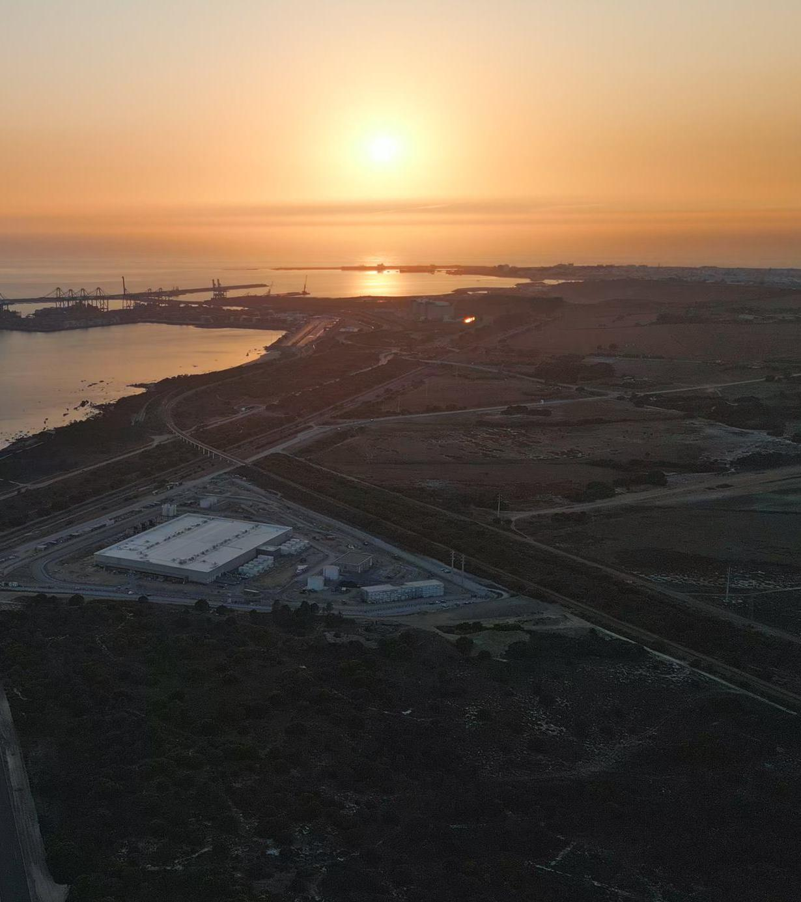

Disclaimer
This document and any files transmitted with it are the property of Start Campus. All rights, including without limitation copyright, are reserved. This document contains information that may be confidential and may also be privileged. It is for the exclusive use of the intended recipient(s) and for the purpose indicated in it. This document and any files transmitted with it do not constitute any form of commitment by Start Campus, they are solely for your information and should not be relied upon for any effects. No liability whatsoever (including negligence or otherwise) is accepted by Start Campus or any of its affiliates, directors, officers, employees, representatives or advisers in relation to any information or opinion contained herein.
Start Campus is registered in Portugal, with number 515949841. Main office address is: START – Sines TransAtlantic Renewable & Technology Campus, S.A., Av. Eng. Duarte Pacheco, Tower 1, Floor 13, 1070-100 Lisboa, Portugal
Thank You
Strictly private and confidential
Notes:
Without connectivity our-AI scale data centers will be just big, expensive fridges.
We would like to thank De-CIX, EXA, Ellalink and other partners who are already connected to our facility.
We need the help of wider connectivity community to continue the development of the subsea and terrestrial networks to help Portugal become the leading European Data hub for the future
In order to deliver this new generation of AI scale facilities we need to work together and continue to think big

